Slide 1

Bachelor’s Thesis Initial Topic Presentation
Monocular Roadside 3D Perception based on Amodal Instance Segmentation
Bach Ngoc Doan
Chair of Artificial Intelligence and Robotics (AIR)
Department of Computer Engineering (CE)
School of Computation, Information and Technology (CIT)
Technical University of Munich (TUM)
I6 Robotics Lab
Schleißheimer Straße 90A
85748 Garching-Hochbrück
October 27, 2023

Slide 2
Content
About Me
Motivation
Approach
Work plan
References
27.10.2023 Bach Ngoc Doan
Notes:
2

Slide 3

About Me
Bach Ngoc Doan
B.Sc. Informatics, 7th semester
My relevant experiences:
Practical course: Cognitive Robotics
09/2022 – 09/2023: working student at msg – automotive & manufacturing sector
Languages: Vietnamese, English, German, Chinese
27.10.2023 Bach Ngoc Doan
Notes:
3

Slide 4
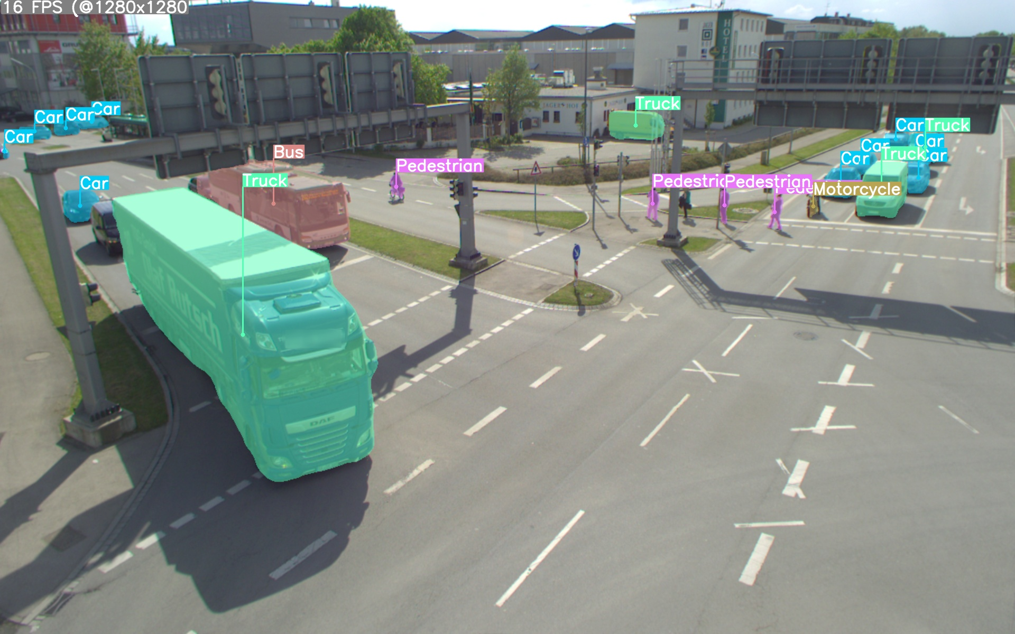
Motivation
The current system uses YOLOv7
Limitation: YOLOv7 can only detect the visible parts of objects
Fig 1: Inference of the existing system on a frame from TUM Traffic Dataset
27.10.2023 Bach Ngoc Doan
Notes:
4

Slide 5
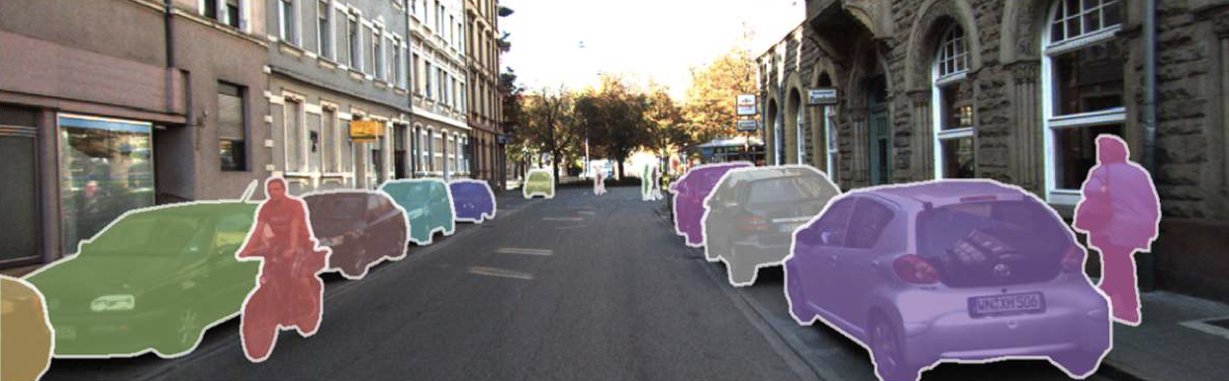
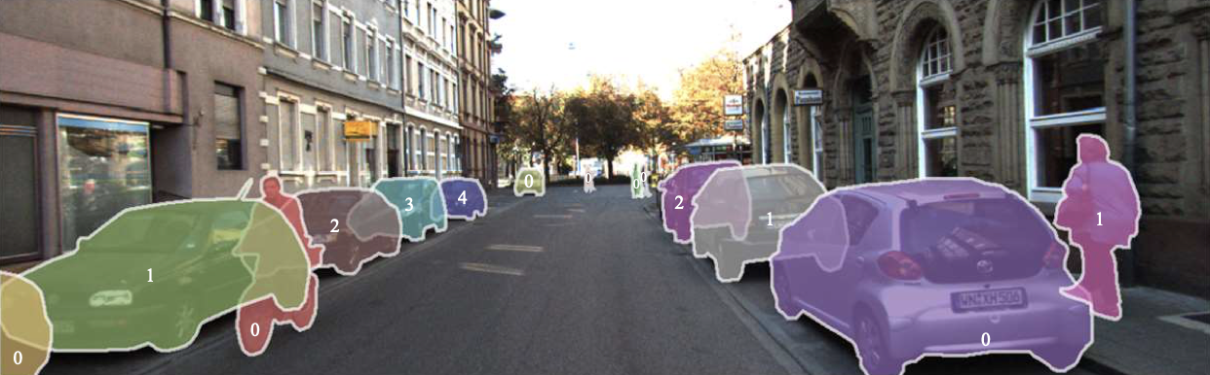
Approach
Exploit amodal instance segmentation (AIS) methods to detect the full shape of objects
Fig 2: Instance Segmentation on a frame from the KINS dataset.
Fig 3: Amodal Instance Segmentation on a frame from the KINS dataset.
27.10.2023 Bach Ngoc Doan
Notes:
5

Slide 6
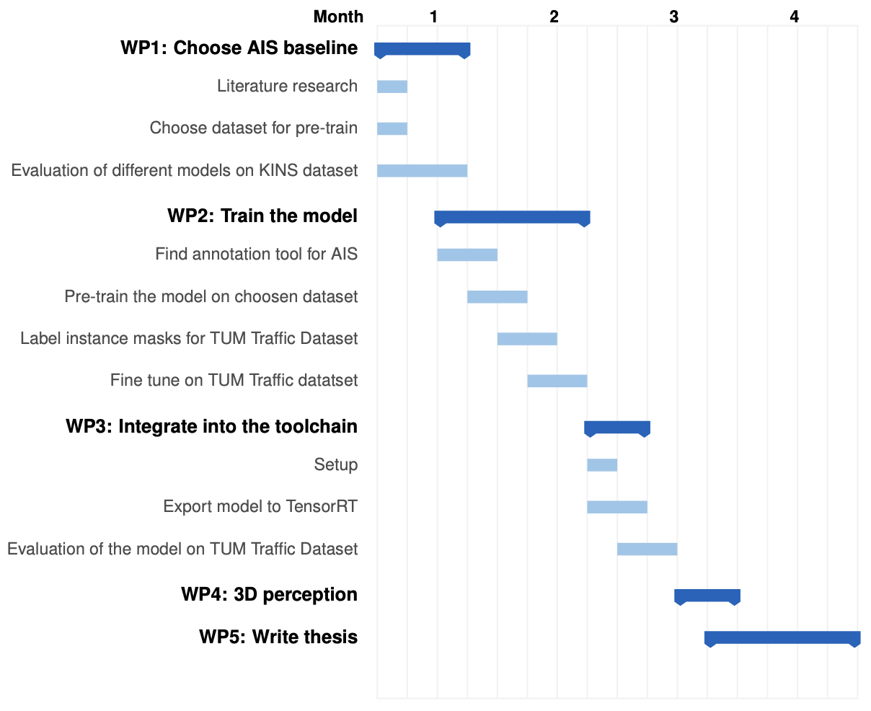
Work plan
27.10.2023 Bach Ngoc Doan
Notes:
6

Slide 7
References
Creß, C., Zimmer, W., Strand, L., Fortkord, M., Dai, S., Lakshminarasimhan, V. and Knoll, A., 2022, June. A9-dataset: Multi-sensor infrastructure-based dataset for mobility research. In 2022 IEEE Intelligent Vehicles Symposium (IV) (pp. 965-970). IEEE.
Zimmer, W., Creß, C., Nguyen, H.T. and Knoll, A.C., 2023. A9 Intersection Dataset: All You Need for Urban 3D Camera-LiDAR Roadside Perception. arXiv preprint arXiv:2306.09266.
Qi, L., Jiang, L., Liu, S., Shen, X. and Jia, J., 2019. Amodal instance segmentation with kins dataset. In Proceedings of the IEEE/CVF Conference on Computer Vision and Pattern Recognition (pp. 3014-3023).
27.10.2023 Bach Ngoc Doan
Notes:
7

